Slide 1
Smart Attendance System [Facial Recognition]
VASAVI COLLEGE OF ENGINEERING
Department of Information Technology
MINI PROJECT
Presented by
Keerthi Gampa 1602-21-737-089
Divya Godala 1602-21-737-082
Anoohya Narsingi 1602-21-737-070

Slide 2
Abstract
Face is the part of the human body that uniquely identifies a person. Using the face characteristics as biometric, the face recognition system can be implemented. We all know that attendance marking is the mandatory thing in any organization. In the previous, old method of attendance system, for example in colleges-the students are called out aloud by the teachers, and their presence or absence is marked accordingly. Later the biometric system like finger prints, iris arrived. However, these kind of techniques are not contact free and are also time consuming and tedious.
In this project, the OpenCV based face recognition approach has been proposed. In this a model a webcam captures an input image, an algorithm for detecting face from an input image, encoding and identifying the face, and marking the attendance in a spreadsheet.

Slide 3
The training database is created by training the system with faces of the authorized students. The images are then stored as a database with respective labels. With this system, it becomes very easy and helpful in taking the attendance in any organization and also all the records will be maintained perfectly without any confusions or complications.
Keywords: attendance, biometric, face recognition, webcam, OpenCV, spreadsheet.

Slide 4

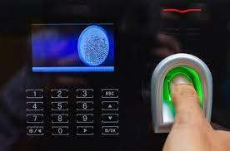
Introduction
Attendance maintenance is a significant function in all the institutions to monitor the performance of the students.
Every institute does this in its own way, by using the old paper or file based systems and some have adopted the strategies of automatic attendance using some biometric techniques.

Slide 5

Face recognition is a powerful field of research which is a computer based digital technology.
Face recognition for the intent of marking attendance is a resourceful application of attendance system.

Slide 6
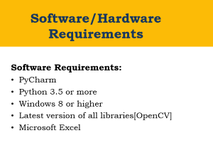
Software/Hardware Requirements
Software Requirements:
PyCharm
Python 3.5 or more
Windows 8 or higher
Latest version of all libraries[OpenCV]
Microsoft Excel
2/10

Slide 7
Software/Hardware Requirements
Hardware requirements:
A standalone computer
Processor : Intel core i5 or above
Memory : 8gb ram or higher
Webcam
Secondary memory to store all images and database
2/10

Slide 8
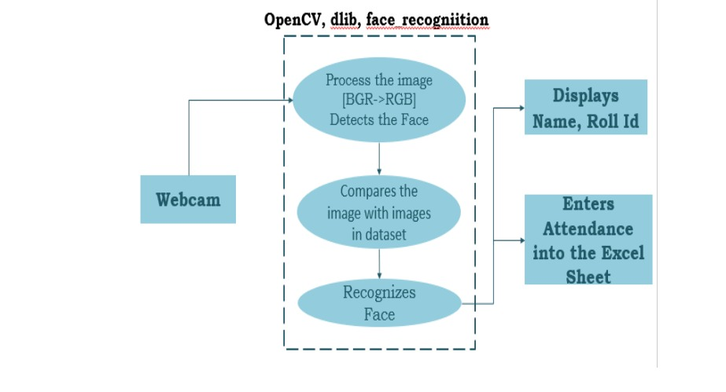
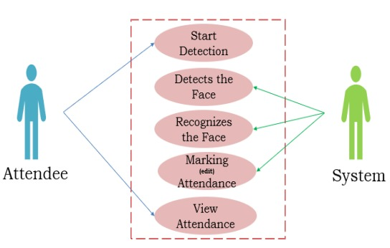
Design

Slide 9
Implementation

Slide 10
Conclusion
This project has been motivated by the desire to design a system that can maintain the attendance records without any proxy. The proposed system will accurately detect the student’s face and also eases the work of Admin. We implemented this project using OpenCV. Here at the end, the attendance will be taken down into the Excel Sheet.

Slide 11
References
[1]. Neha Kumari Dubey, Pooja M.R., K Vishal, Dhanush
Gowda H.L, Keertiraj B.R: “Face Recognition based
Attendance System”, International Journal of Engineering
Research & Technology(IJERT), Vol. 09, Issue. 06, Pub.
24-06-2020.
[2]. Sudhir Bussa, Ananya Mani, Shruti Bharuka, Sakshi
Kaushik: “Smart Attendance System using OPENCV based on
Facial Recognition”, International Journal of Engineering
Research & Technology(IJERT), Vol. 09, Issue. 03,pub.
11-03-2020.

Slide 12

Q and A?
?

Slide 13


